Slide 1



ABC Telecom Ltd
Complaint Redressal System

Slide 2
Team Members
Name of the Developer Employee ID
Prasanth B 2530296
Sarath C 2530007
Rehan S 2530195
Satish N 2530086
Ayush Singh 2530415
Meda Ganesh 2530215
ArunKumar 2530018
Raghavenra Reddy 2530156
Pulivendula Jameel Ahmed 2530148

Slide 3

Index
Introduction
Project Details
Flow Chart
Admin Module
Customer Module
Complaints & Feedback Module
Manager Module
Engineer Module
Benefits
Tools & Technologies
Conclusion

Slide 4

Introduction
In this project we have created a Complaint In this project, we developed a Complaint Redressal System, a responsive and dynamic java web application that enables customers to submit online complaints about problems with their landline, cell phone, and fiber optic broadband services.

Slide 5
Project Details
Domain: Telecom
Project Objective: Create a dynamic and responsive Java Complaint Redressal System web application for online complaint management system where the customers can raise complaints regarding their landlines and broadband services.
Background of the project: ABC Telecom Ltd. is one of India’s major telecommunication service providers offering landline, mobile phone and Fiber optic broadband services across the country. Their customer services group is interested in providing a set of customer redressal services through the development of a new application using the state-of-art technologies such as Spring-boot for the development of java-based services, and UI using Angular and integrate them suitably, so that all the necessary services are taken care of through this application. They want to have an online complaint management system where the customers can raise complaints regarding their landlines and broadband services

Slide 6
Flow Chart
ADMIN
REGISTER
CUSTOMER
LOGIN
MANAGER
ENGINEER
REGISTER
LOGIN
REGISTER
LOGIN
ABC TELECOM
RAISING OF COMPLAINT
CHECKING THE STATUS
GIVING FEEDBACK
CHECKING THE COMPLAINT IN PARTICULAR AREA AND ASSIGNING TO THE REQUIRED ENGINEER
CHECKING THE COMPLAINT AND RESOLVING
UPDATING THE STATUS
ADMIN CAN VIEW THE STATUS OF MANAGER , ENGINEER, CUSTOMER, COMPLAINT, FEEDBACK.

Slide 7
FLOW CHART METHODOLOGY
The objective of this project is to create a dynamic and responsive Java Complaint Redressal System web application for an online complaint management system where users may submit complaints regarding their landline and broadband services.
The admin can view, update, delete the lifecycle of several customer complaint categories, including managers, engineers, and customers.
This web application enables the manager to login and check the ticket raised by the customer of the same pin code, after which the manager will assign an engineer to check and resolve the ticket raised by the customer. The engineer will then update the status regarding the specific ticket, and the customer can provide feedback on the service.

Slide 8
ADMIN MODULE
ADMIN
ADMIN PORTAL
VIEWING MANAGERS
VIEWING ENGINEERS
VIEWING CUSTOMERS
VIEWING COMPLAINTS
VIEWING STAUS AND FEEDBACKS
FUNCTIONALITIES
READING, UPDATING,DELETING CONTENT FROM THE SPECIFIC MODULES

Slide 9
ADMIN MODULE
Admin is the super user of the system he/she should have to maintain the lifecycle of Customer, Manager, Engineer.
Admin can be able to view the complaints and status of the complaints along with the feedback which is provided by the customer .
Admin can be able to update the status .
Admin can be able to delete the complaints, feedback, status.

Slide 10
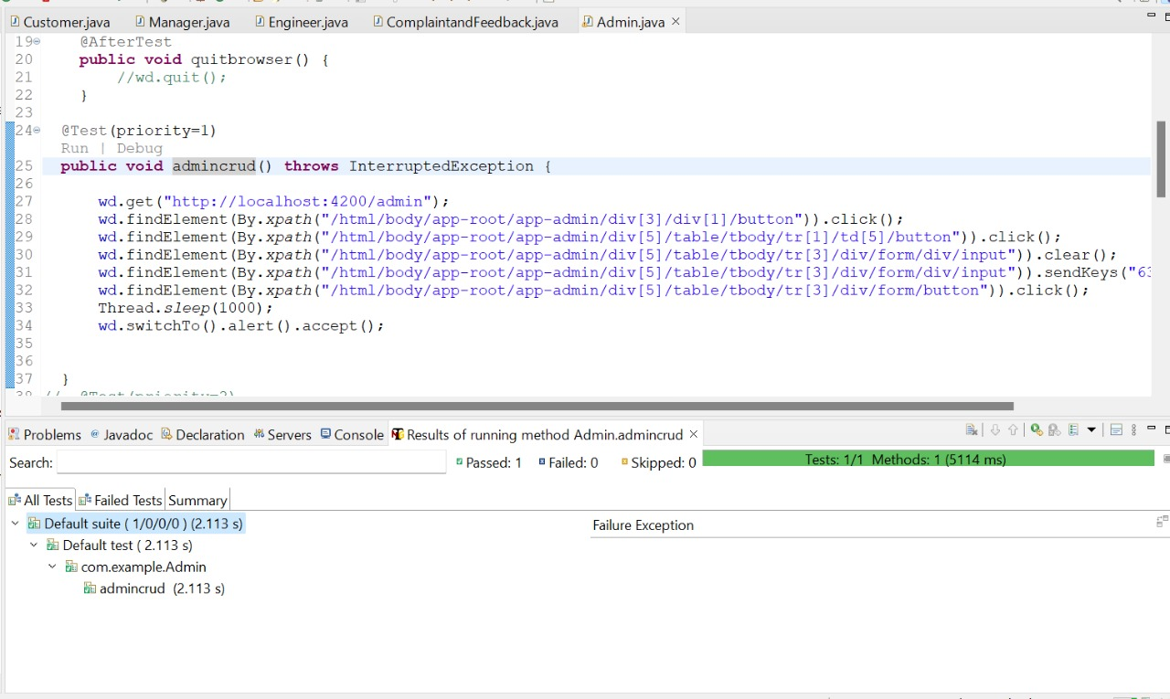
TESTNG TESTING: -( Frontend)
ADMIN module:

Slide 11
CUSTOMER MODULE
CUSTOMER
REGISTER
E-MAIL
PASSWORD
NAME
MOBILE NUMBER
ADDRESS
PINCODE
LOGIN
ENTER E-MAIL
PASSWORD

Slide 12
CUSTOMER MODULE
Customer should have to register with all the required details in the portal.
After successful registration popup will rise.
To raise a complaint customer should have to login with correct email and password.
After successful login Customer can raise a complain by providing the following minimal details like Name, Address , PIN Code, Mobile number and type of problem to raise a complaint.
Once the complaint is submitted then the ticket will be raise and shared to manager .

Slide 13
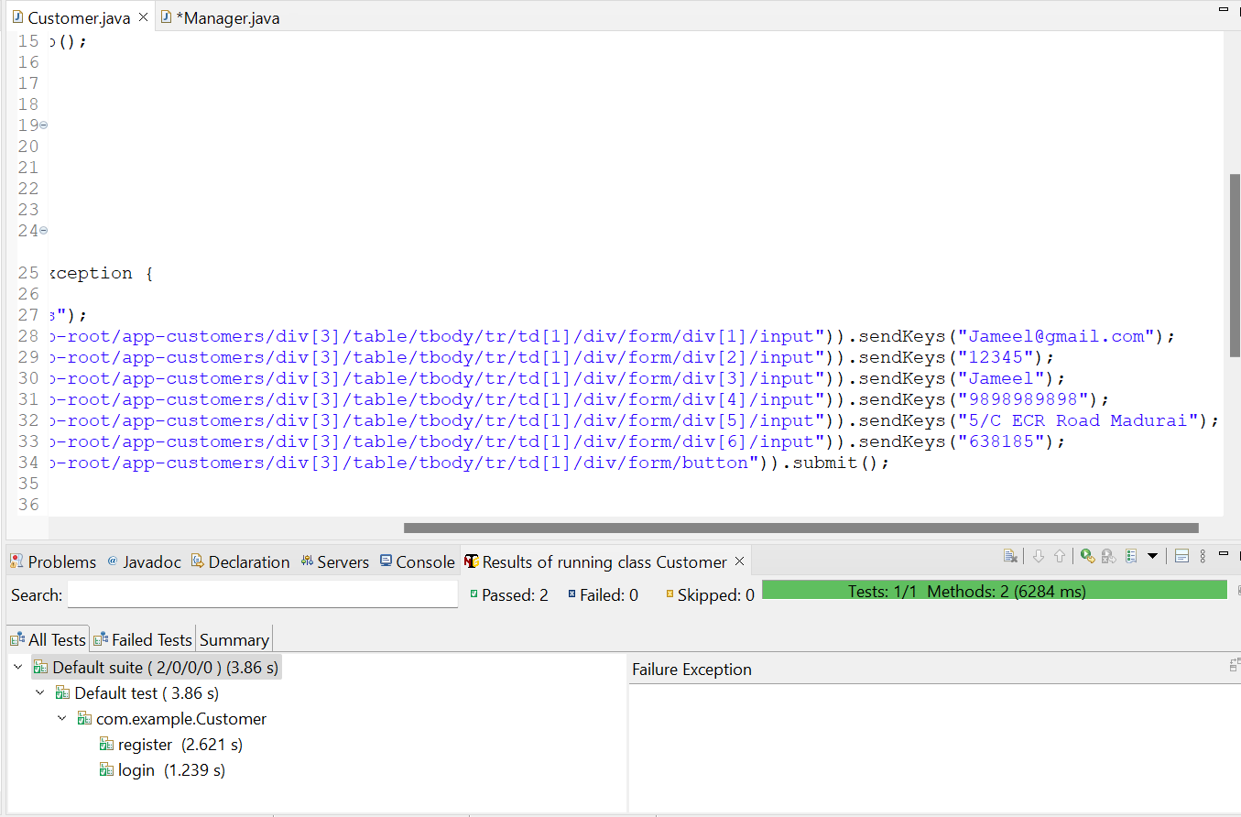
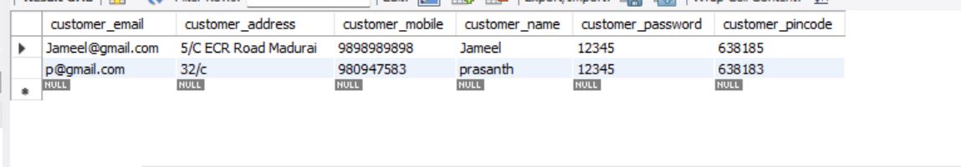
TESTNG TESTING: - ( frontend )
Customer frontpage:

Slide 14
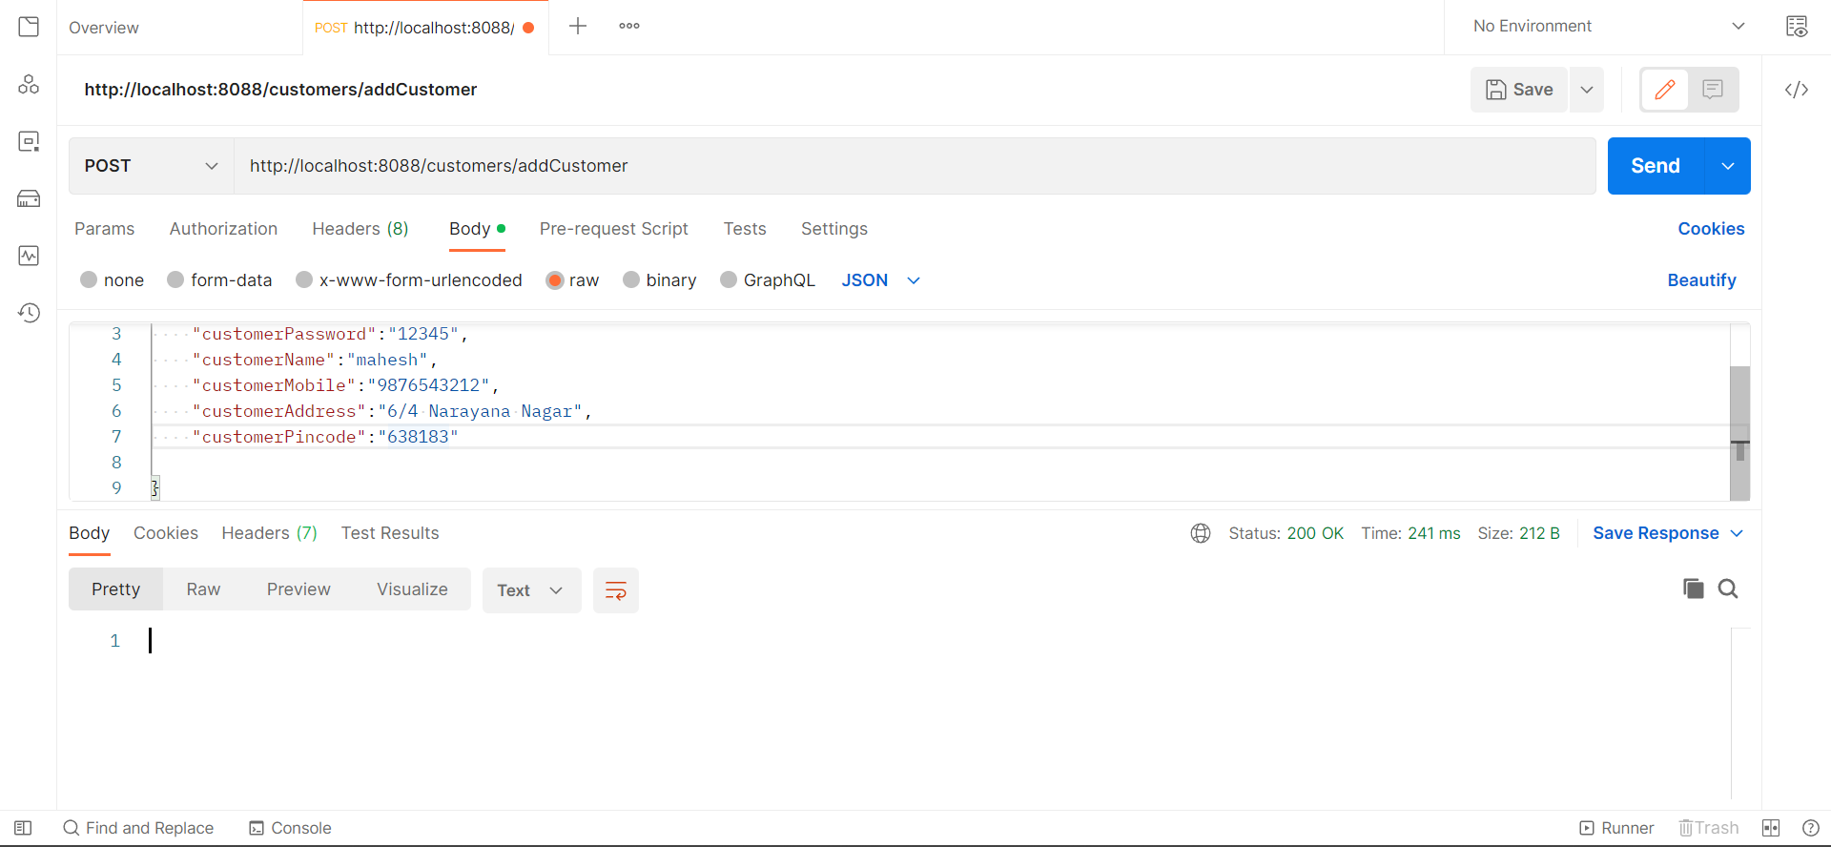
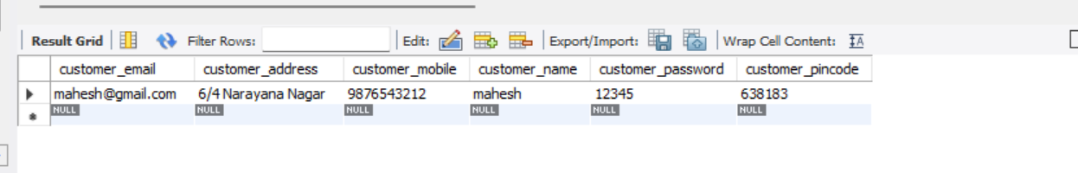
POSTMAN TESTING: - (BACKEND)
Customer Register:
POSTMAN TESTING:

Slide 15
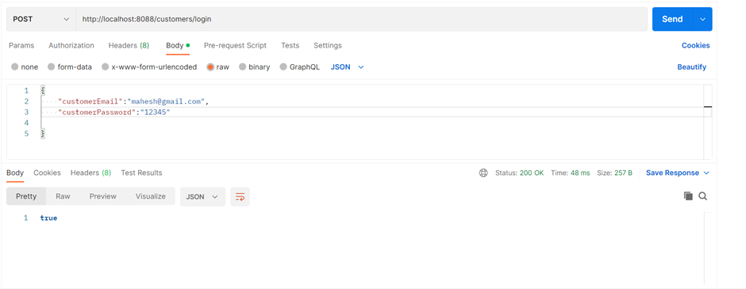
Customer Login:

Slide 16
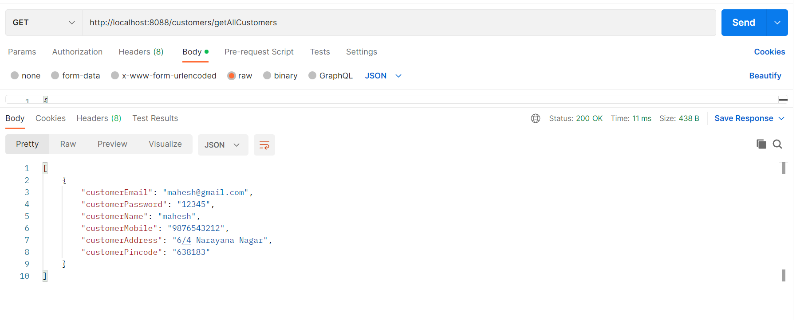
View all customer:

Slide 17
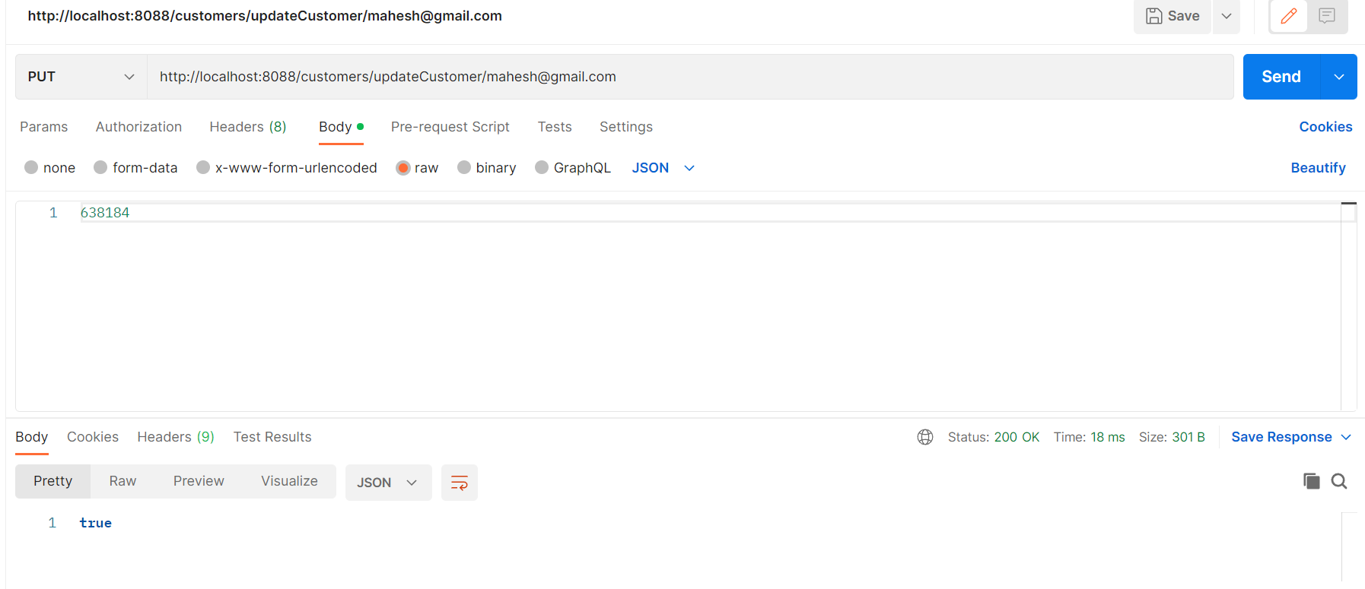
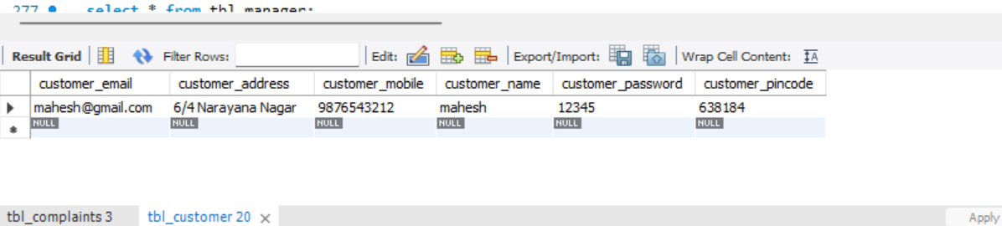
Update customer pincode:

Slide 18
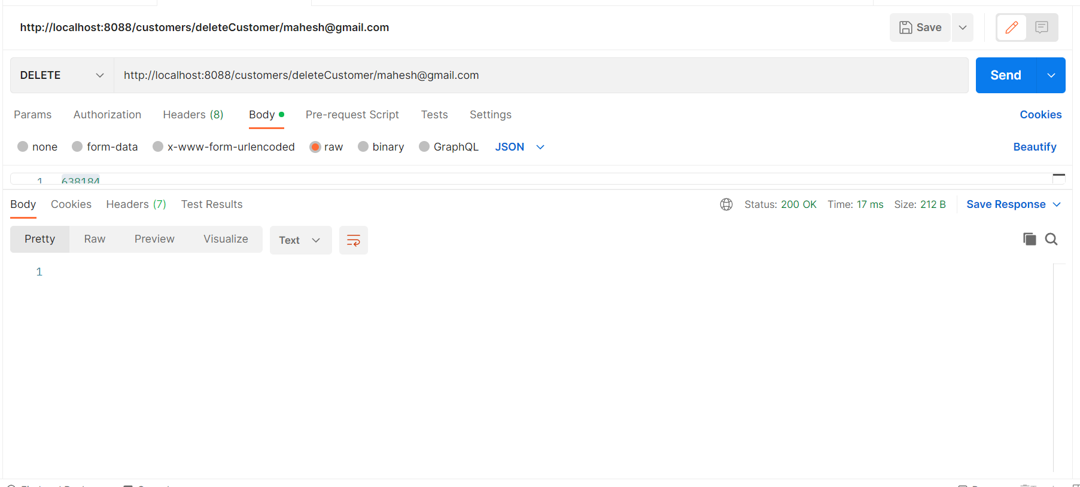
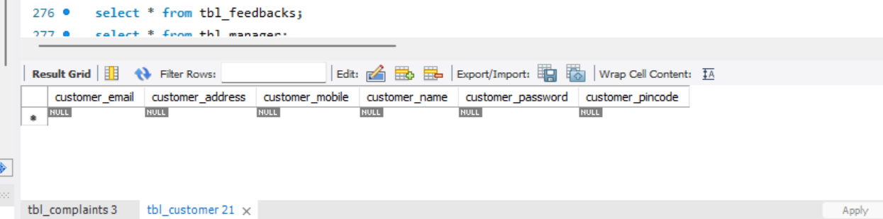
Delete customer:

Slide 19
COMPLAINTS & FEEDBACK MODULE
E-MAIL
PINCODE
COMPLAINT
STATUS
COMPLAINTS
VIEW FEEDBACK
TICKET ID
E-MAIL
FEEDBACK

Slide 20
COMPLAINTS & FEEDBACK MODULE
Complaint and feedback is very important for complaint redressal system.
When the customer login into portal he can raise complaints regarding to issue faced by them. By filling the required details in the portal.
Once customer submit the complaint, the ticket will be raised after that he can view the status of complaints and feedback also.
In the feedback part customer can give the feedback based on the service provided to them.

Slide 21
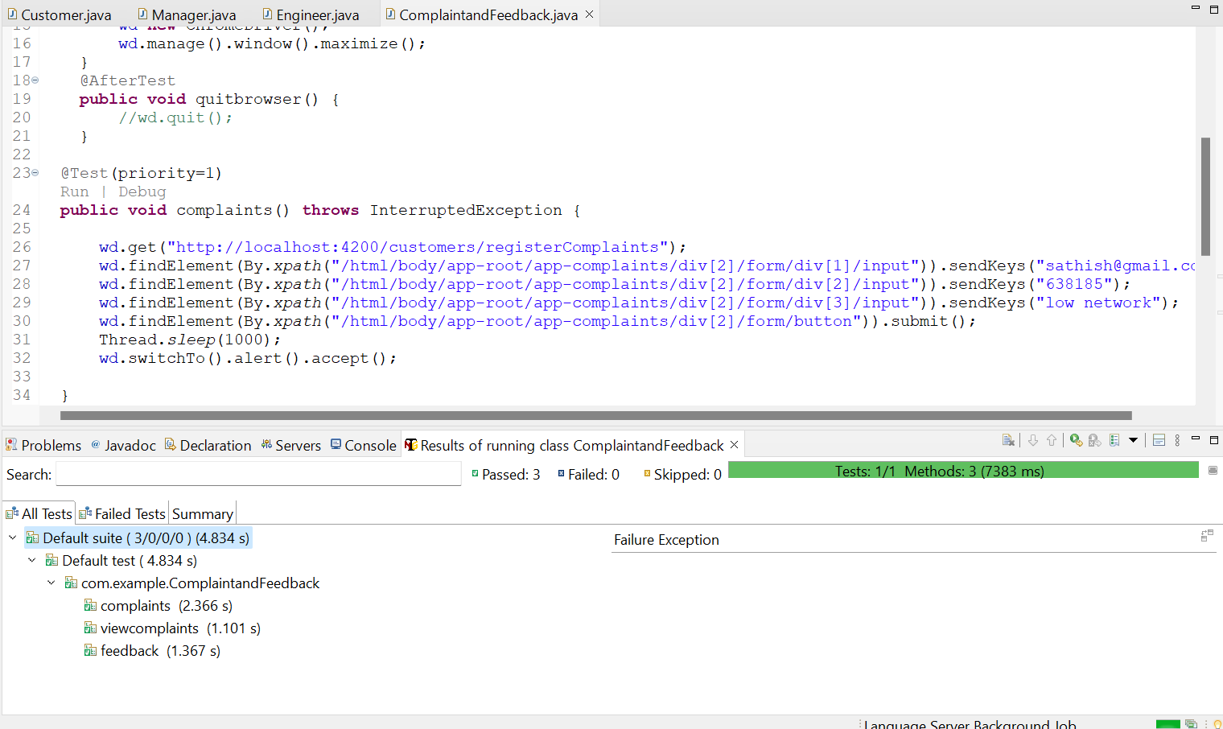
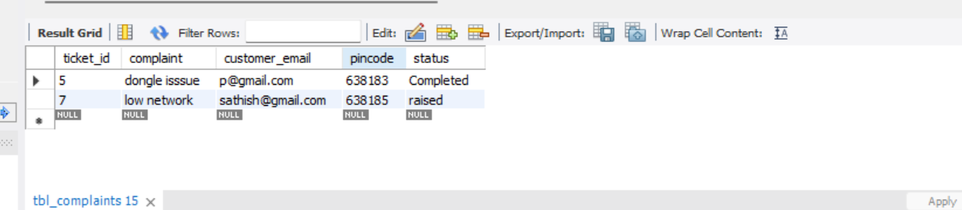
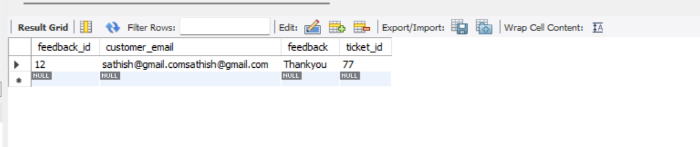
TESTNG TESTING: -( frontend)
Complaint and feedback:

Slide 22
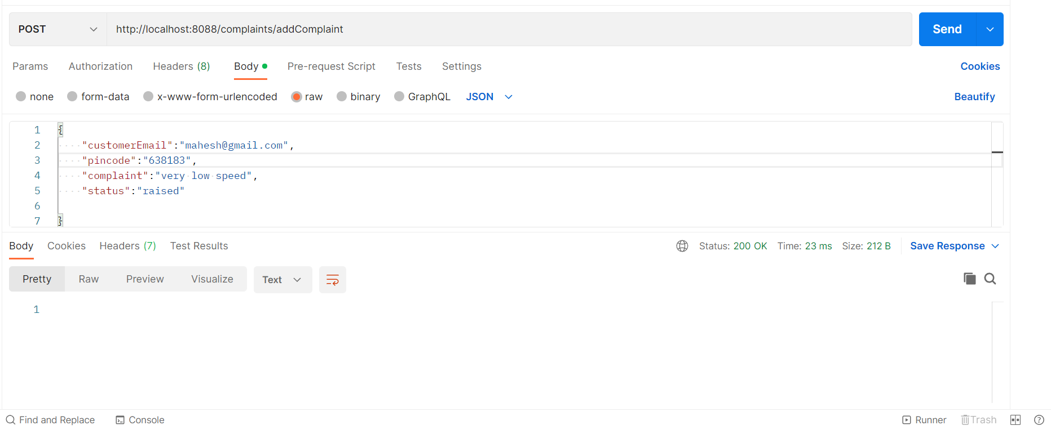
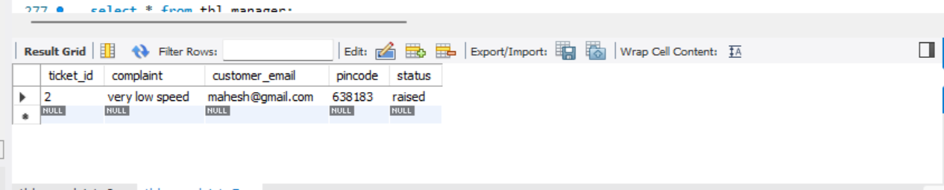
Add Customer Complaints:
POSTMAN TESTING: - (BACKEND)

Slide 23
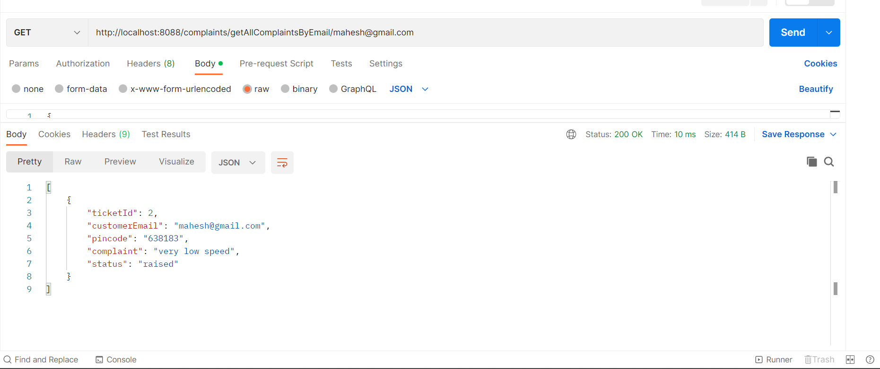
Customer Tracking:

Slide 24
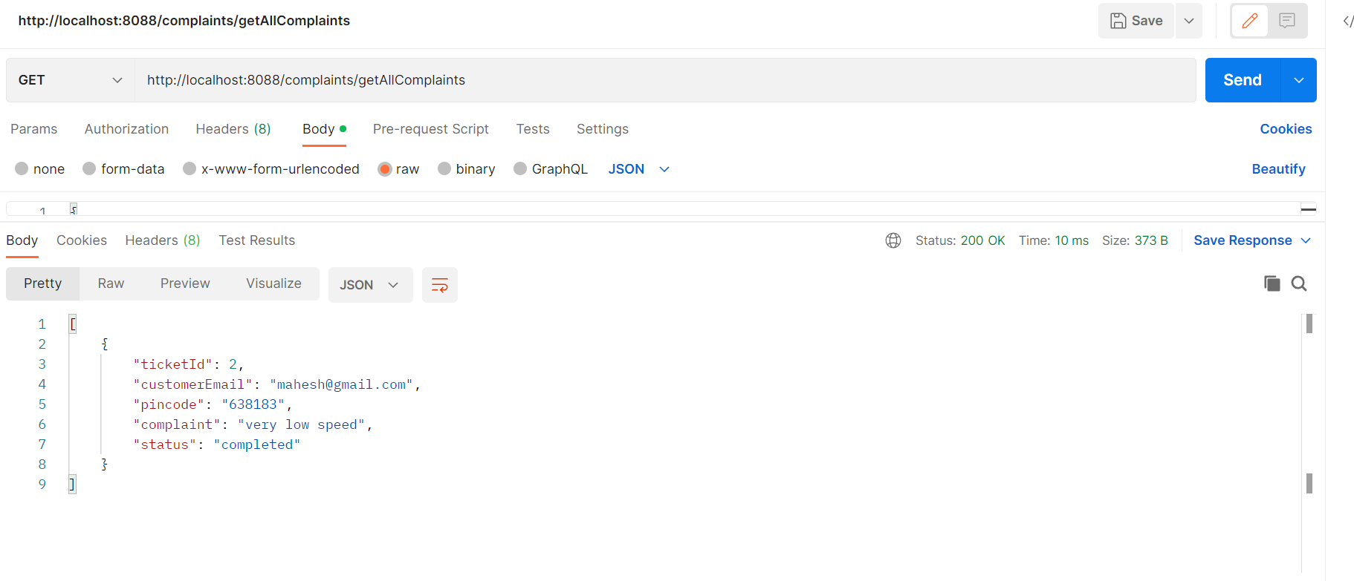
View all complaints:

Slide 25
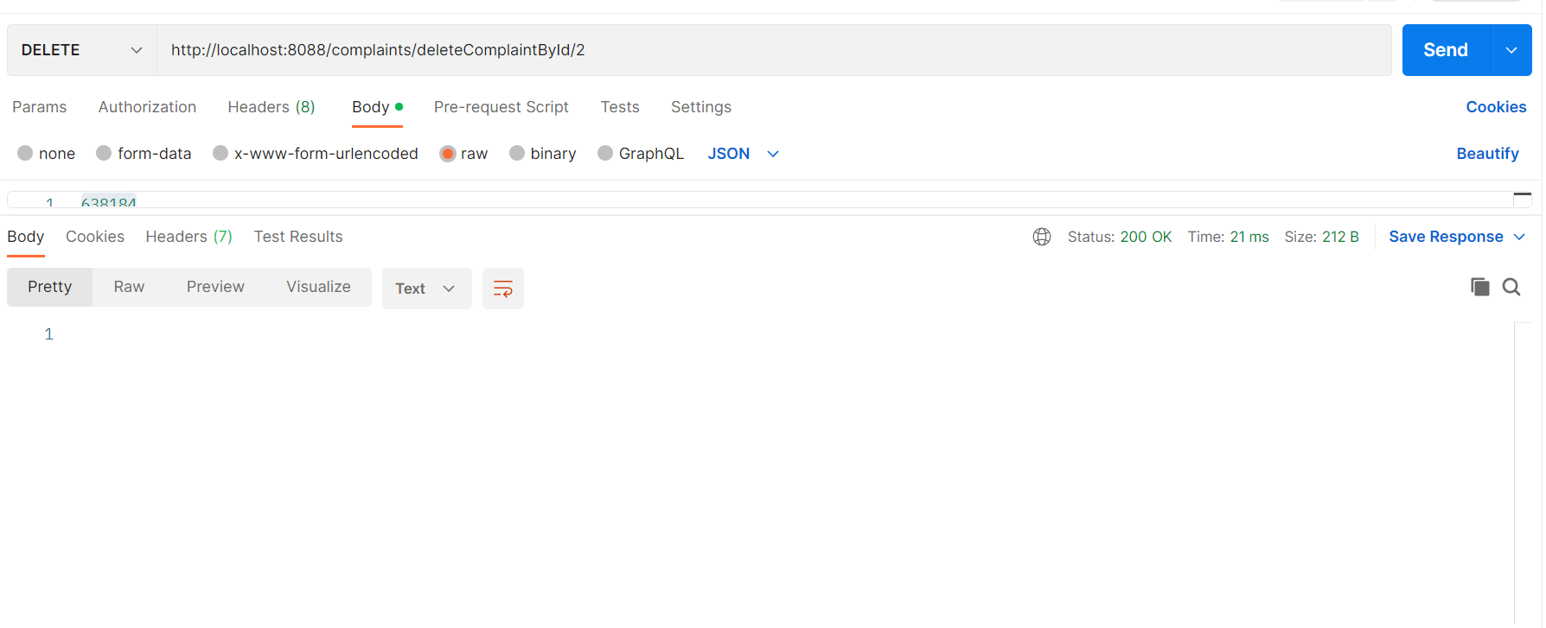
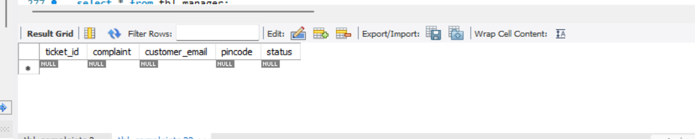
Delete complaints:

Slide 26
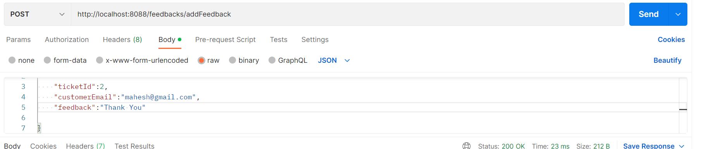
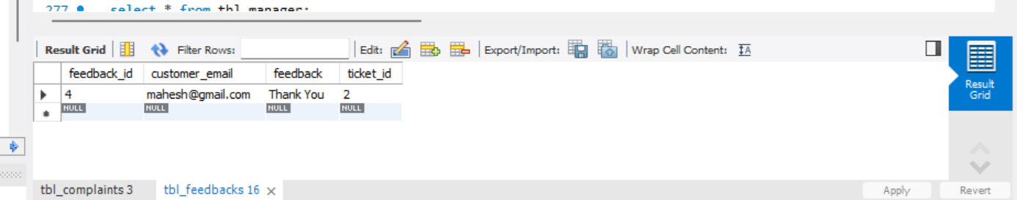
Customer feedback:

Slide 27
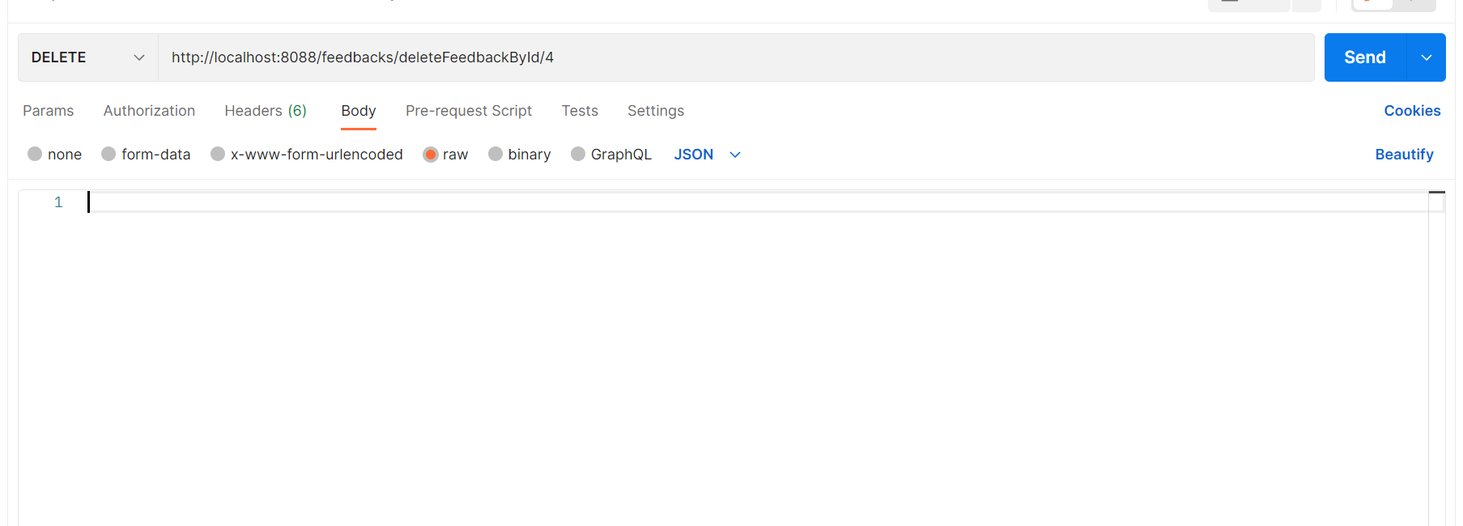
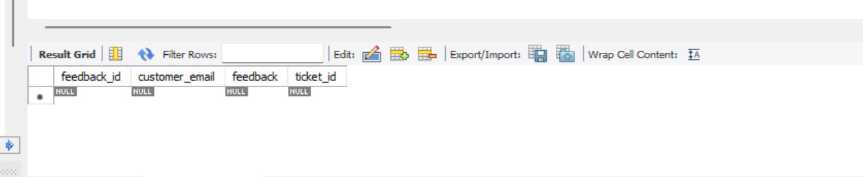
Delete feedback:

Slide 28
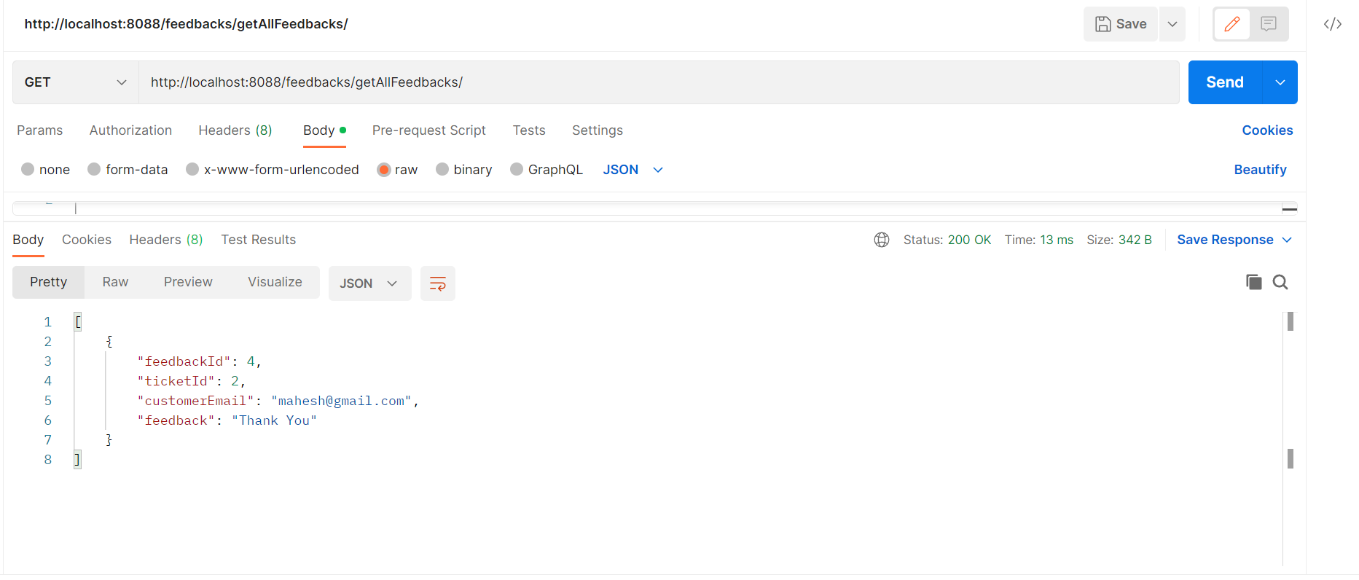
Manager can see the feedback:

Slide 29
Manager Module
MANAGER
REGISTER
ENTER EMAIL
ENTER PASSWORD
ENTER NAME
ENTER PINCODE
LOGIN
ENTER EMAIL
ENTER PASSWORD
CUSTOMER EMAIL
TICKET ID
COMPLAINT
STATUS
ASSIGN ENGINEER

Slide 30
Manager Module
In our module manager plays a very important role, after logging in into the portal manager can be able to see the tickets raised by the customer.
The manager can be able to get the details of the customer like email and pincode , along with that can be able to view the ticket id and complaint raised by customer and status.
once the complaint is raised by the customer the manager pick up the active tickets and assign an engineer based on the pin code of the customer to resolve the issue.

Slide 31
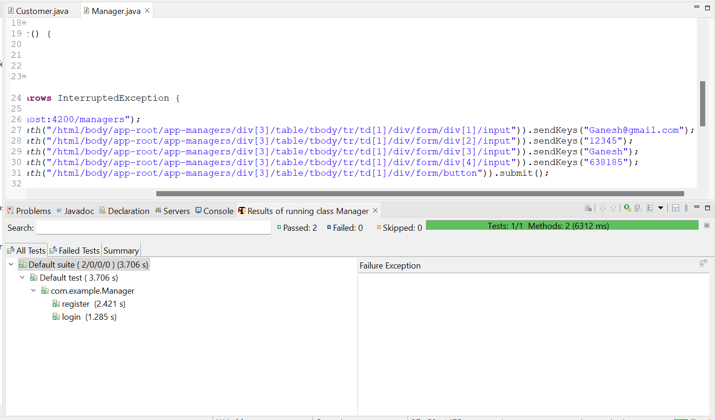
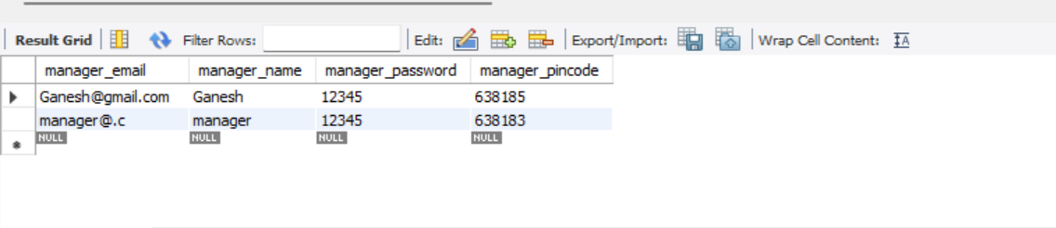
TESTNG TESTING: - (FRONTEND)
Manager frontpage:

Slide 32
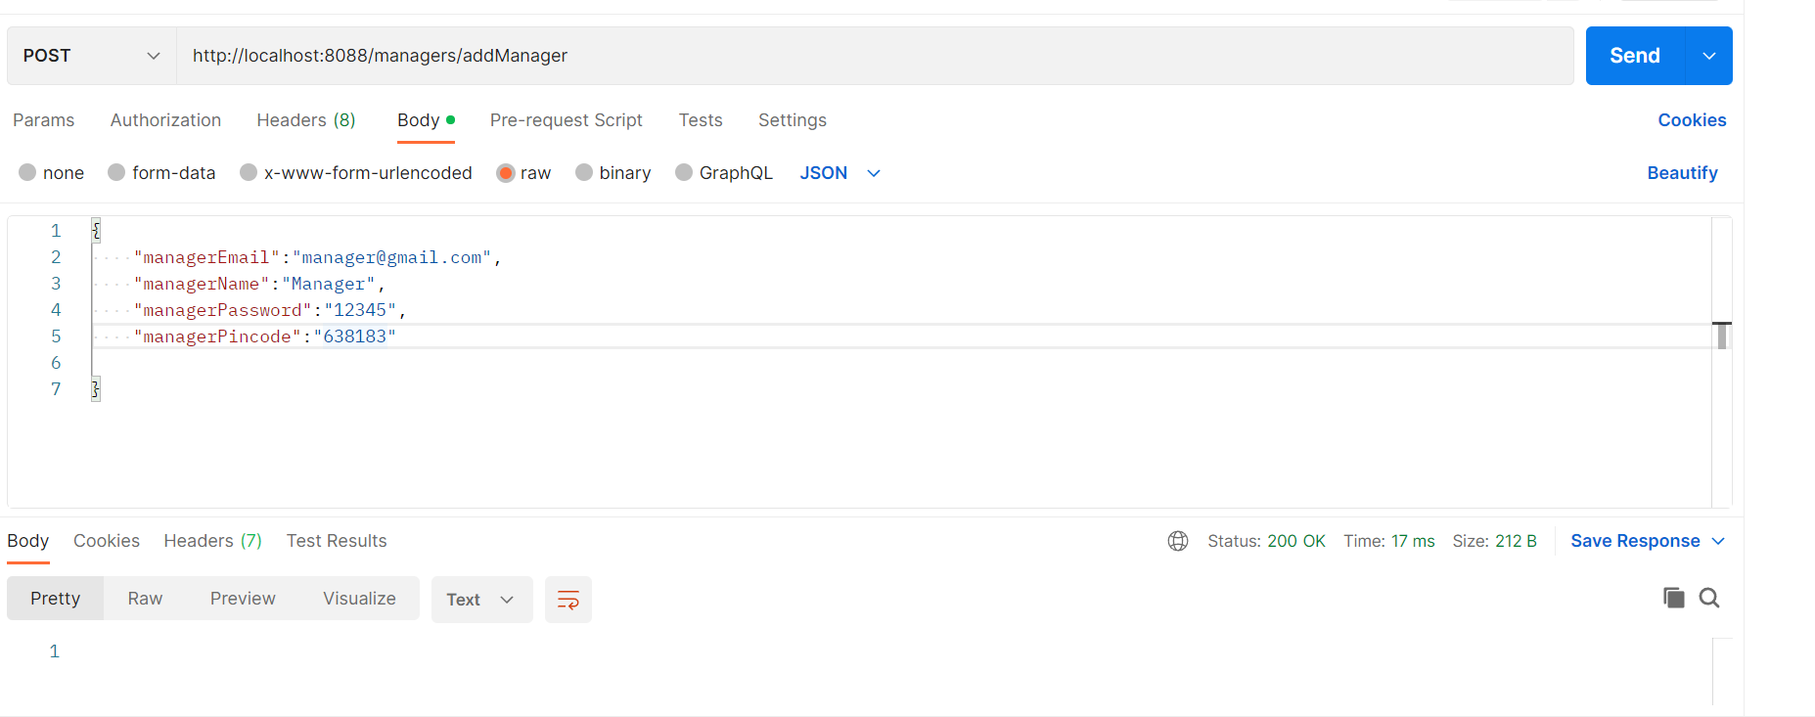
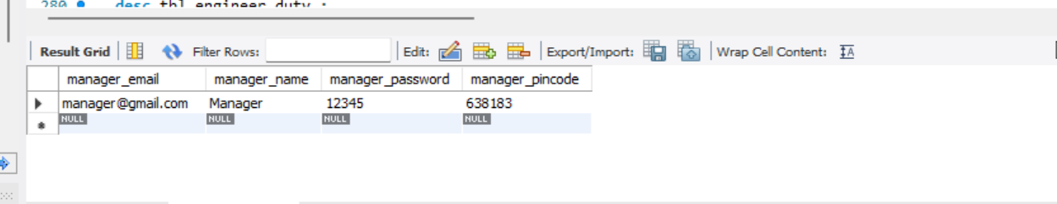
POSTMAN TESTING: - ( backEND)
Manage Register:

Slide 33
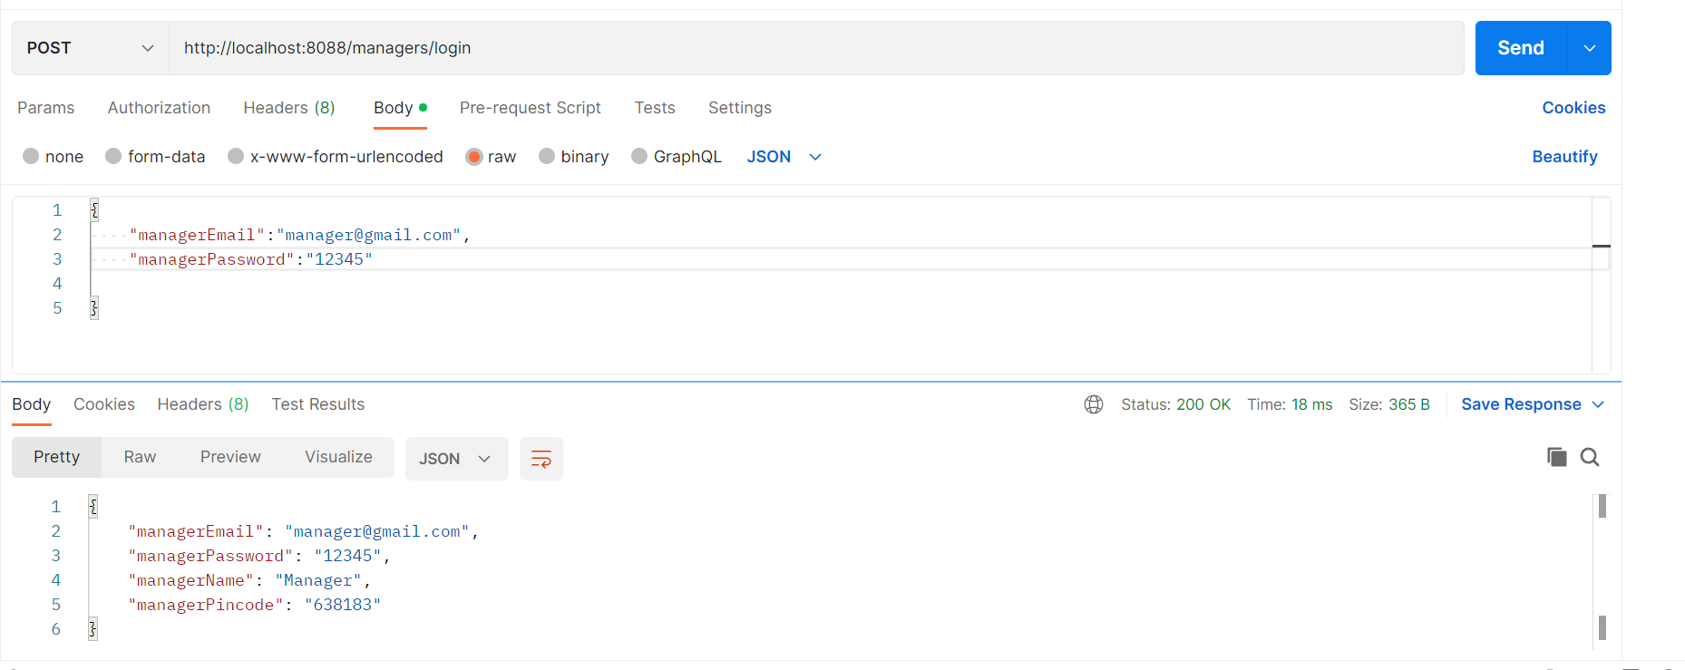
Manager Login:

Slide 34
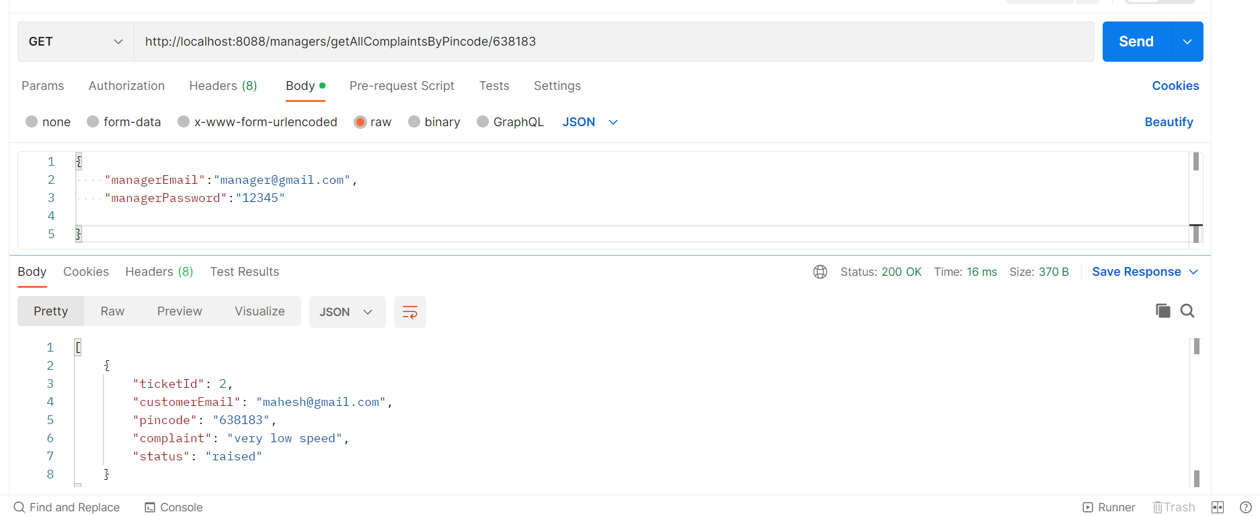
Manager can view the customer complaints:

Slide 35
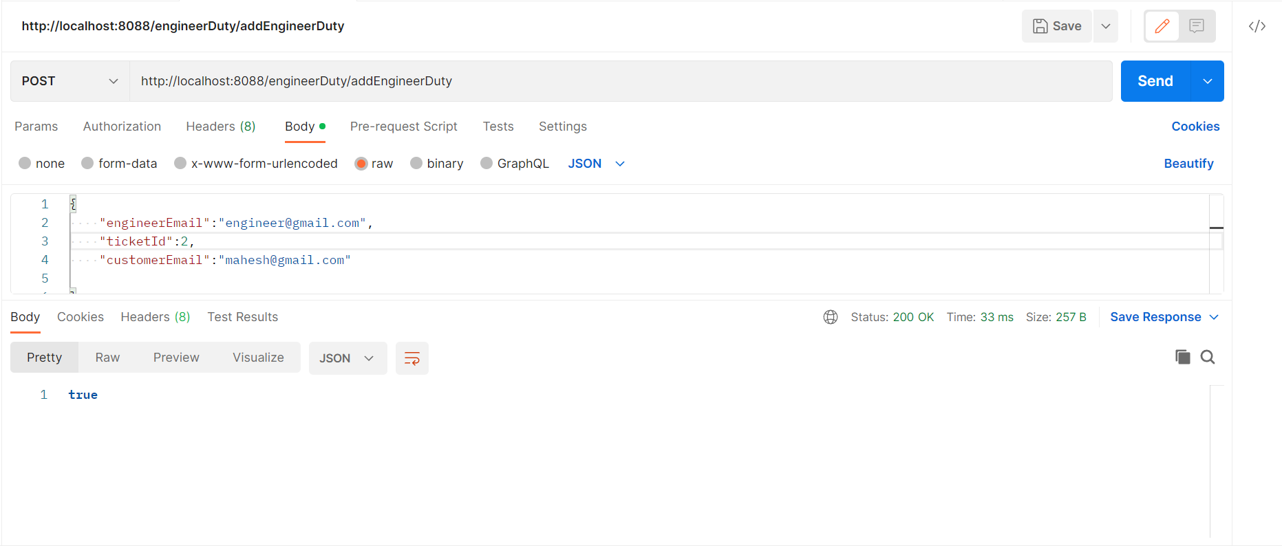
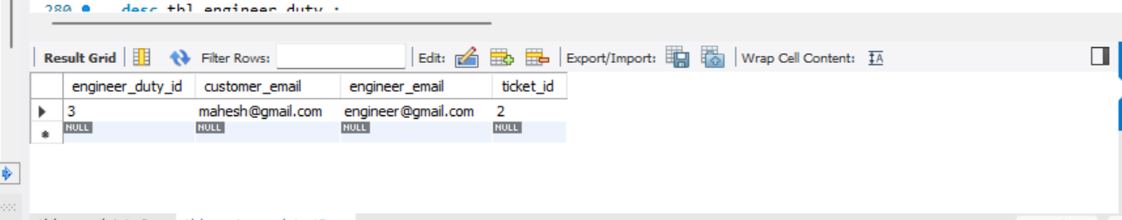
Assigning manager to engineer:

Slide 36
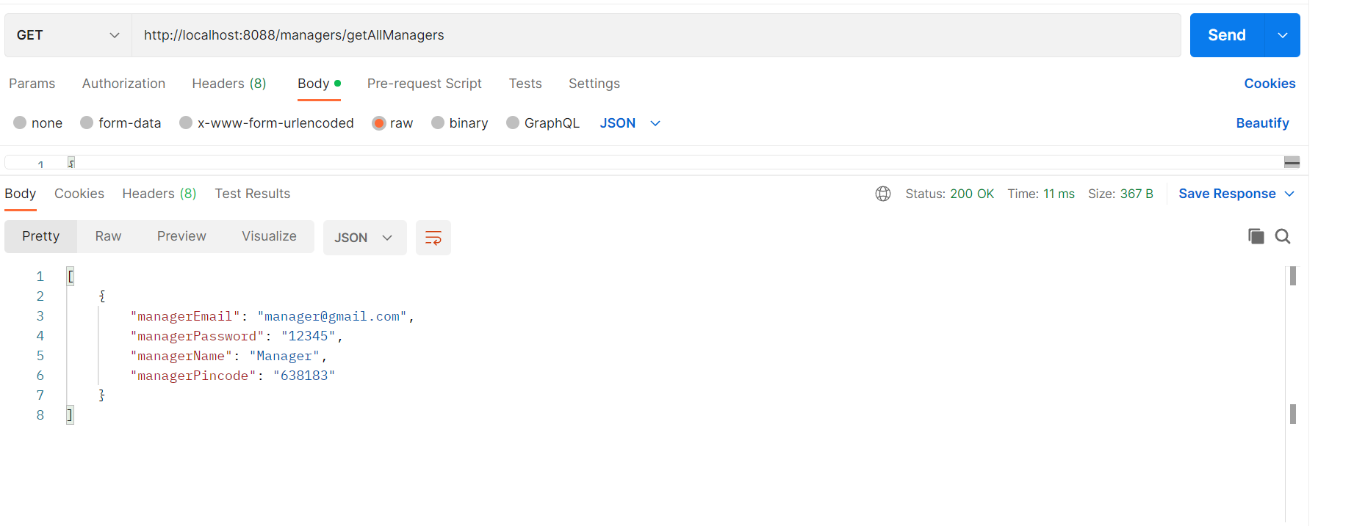
View all Manager:

Slide 37
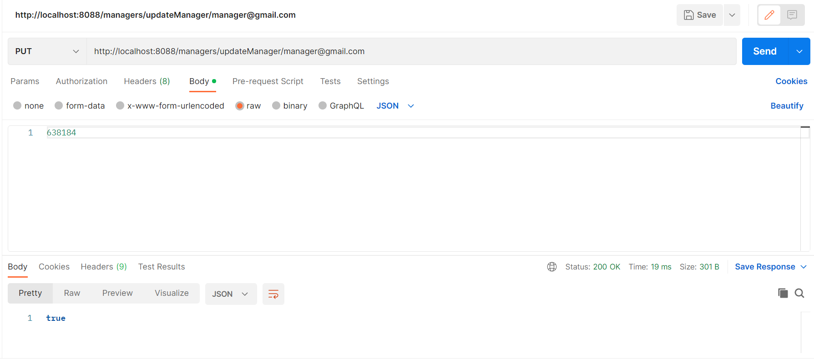
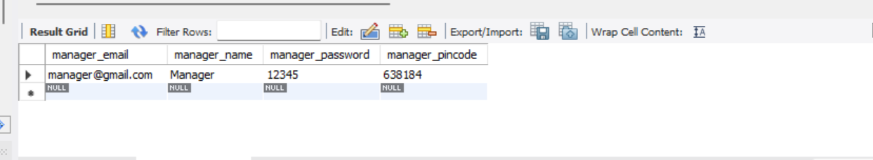
Update Manager Pincode:

Slide 38
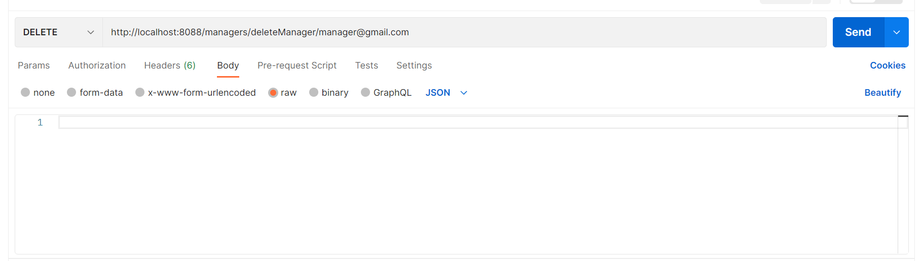
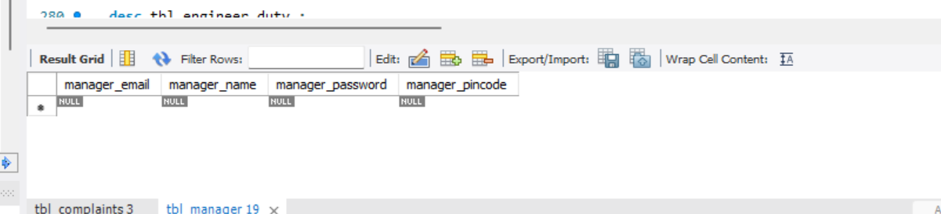
Delete manager:

Slide 39
ENGINEER MODULE
ENGINEER
REGISTER
ENTER EMAIL
ENTER PASSWORD
ENTER NAME
LOGIN
ENTER EMAIL
ENTER PASSWORD

Slide 40
ENGINEER MODULE
Complaint redressal system enables the engineer to login after logging in the engineer will be able to see the tickets which are assigned to them based the of the customer .
The engineer have to resolve the complaint and update the status of the ticket which is visible to all the other main members of the redressal system.
Complaints redressal system software is used to record resolve and respond to customer complaints, requests as well as facilitate any other feedback.

Slide 41
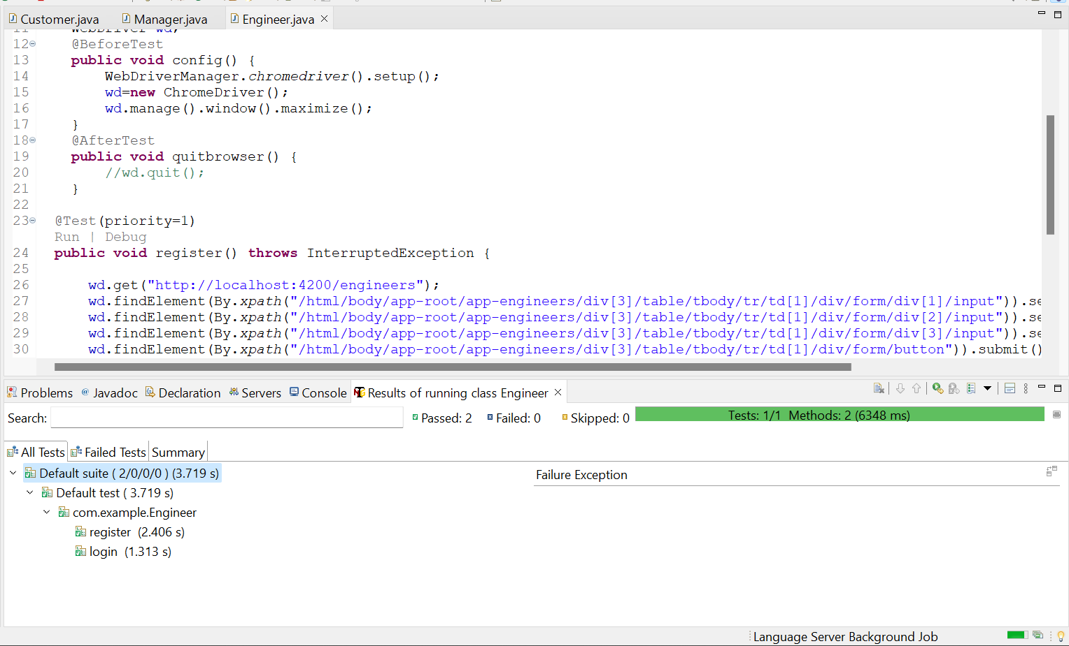
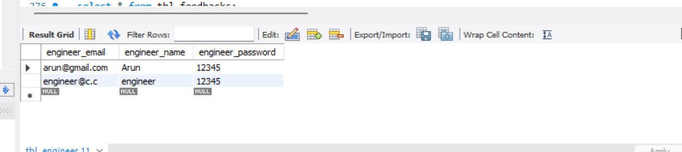
TESTNG TESTING: - ( FRONTEND)
Engineer front page:

Slide 42
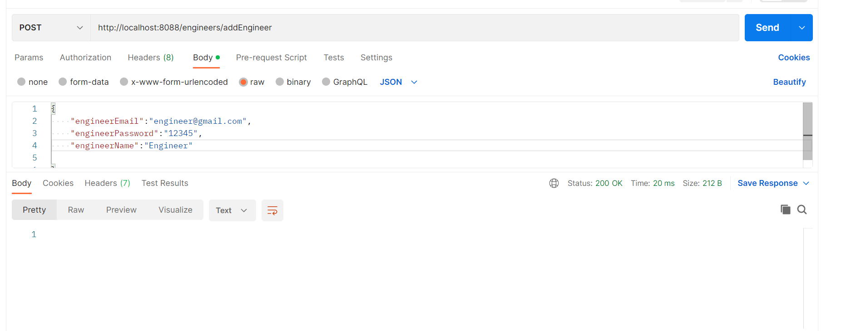
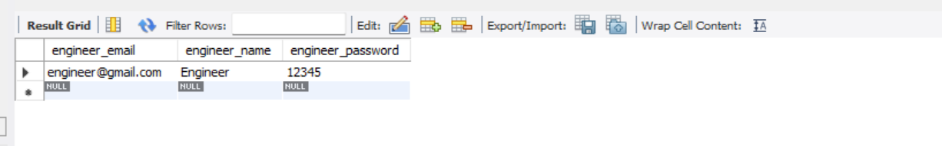
POSTMAN TESTING: - (Backend)
Engineer register:

Slide 43
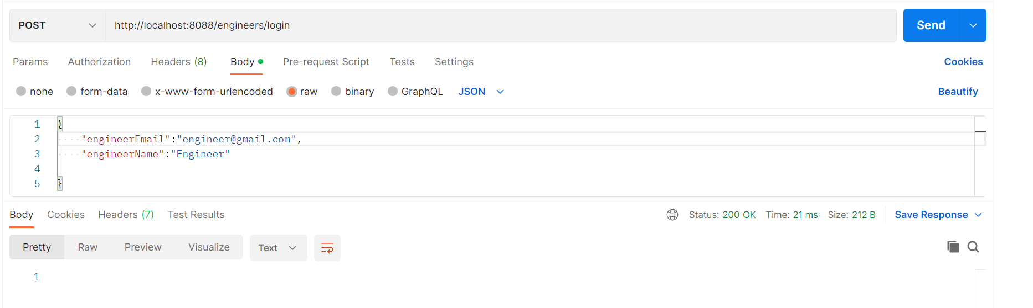
Engineer Login:

Slide 44
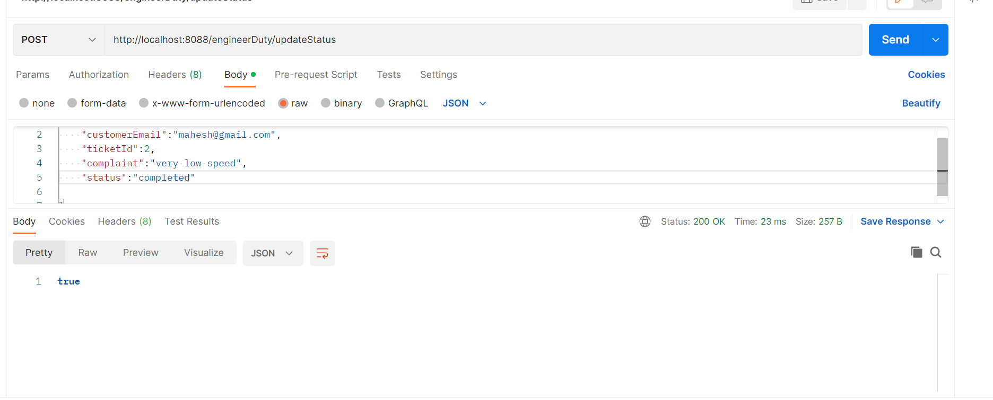
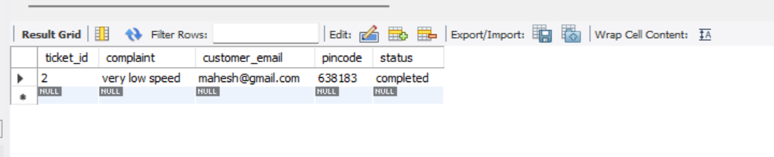
Engineer status:

Slide 45

View all engineer:

Slide 46
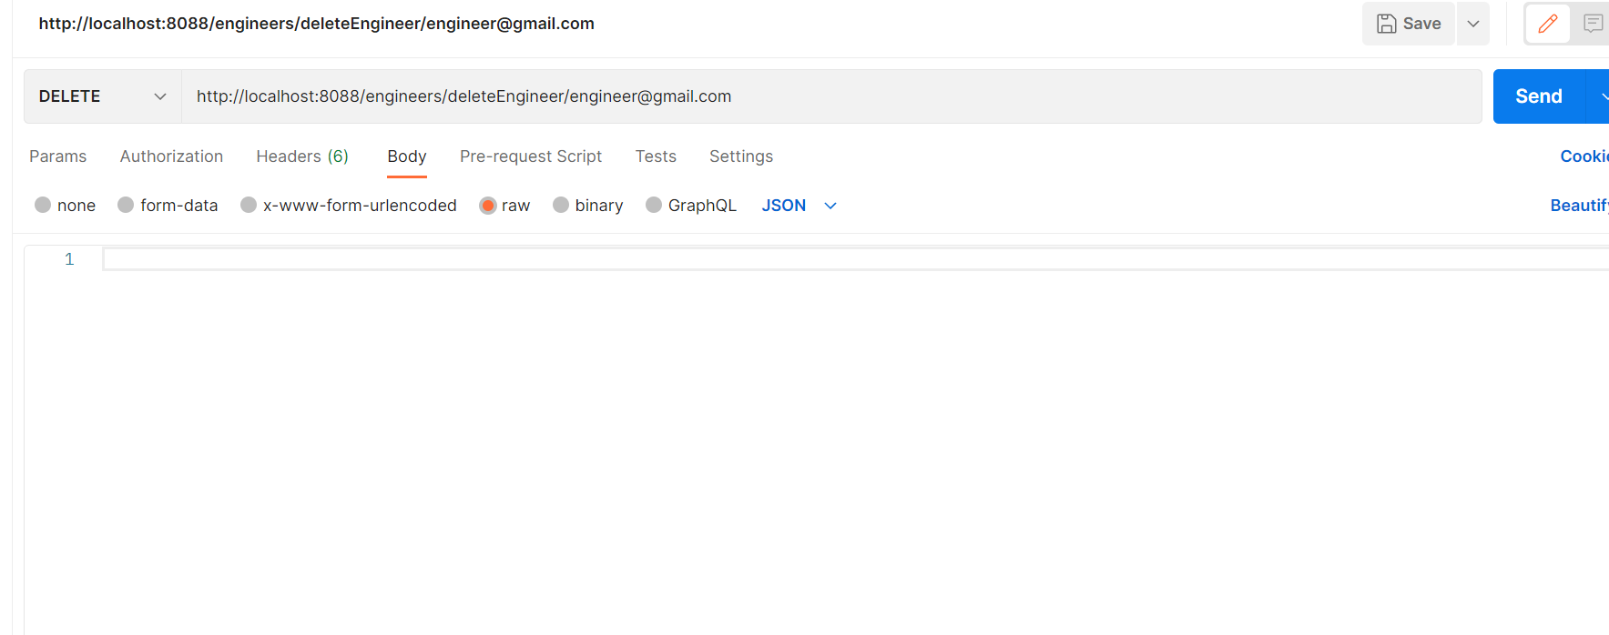
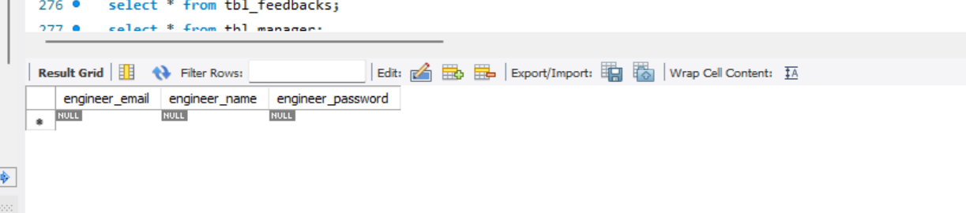
Delete engineer:

Slide 47
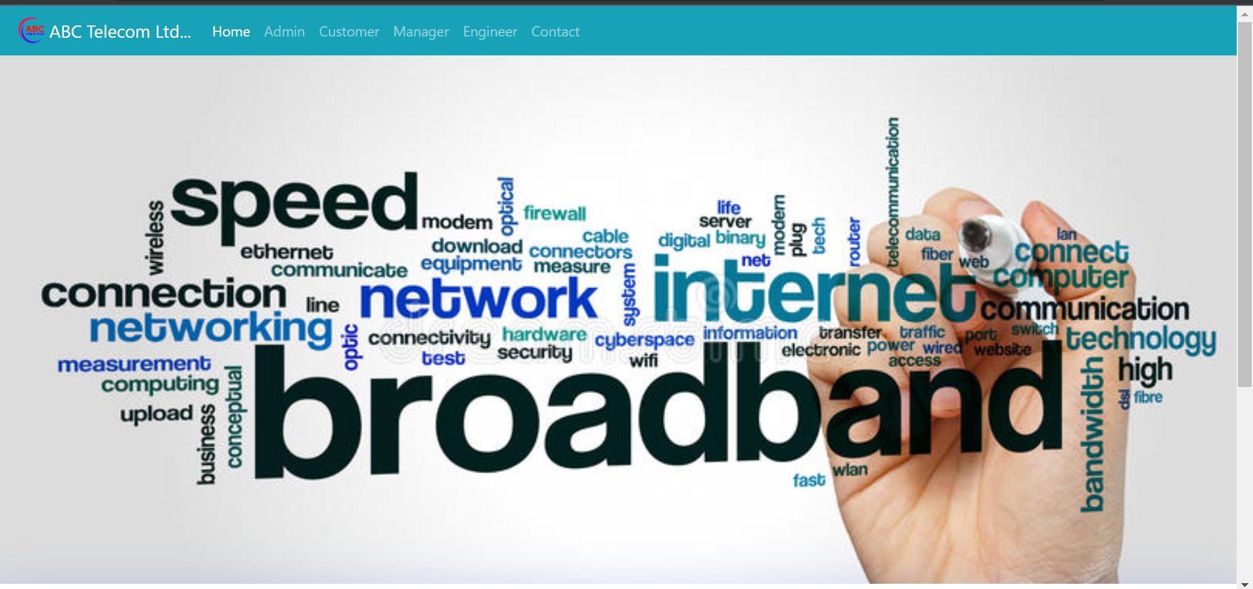
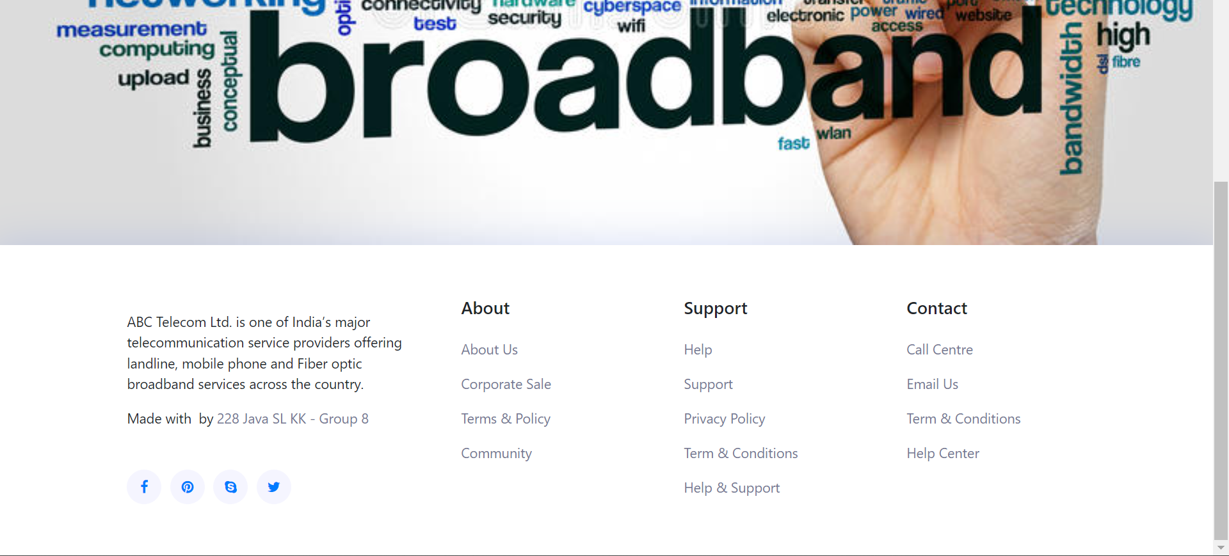
OUTPUT OF COMPLAINT REDRESSAL SYSTEM
Home Page:

Slide 48
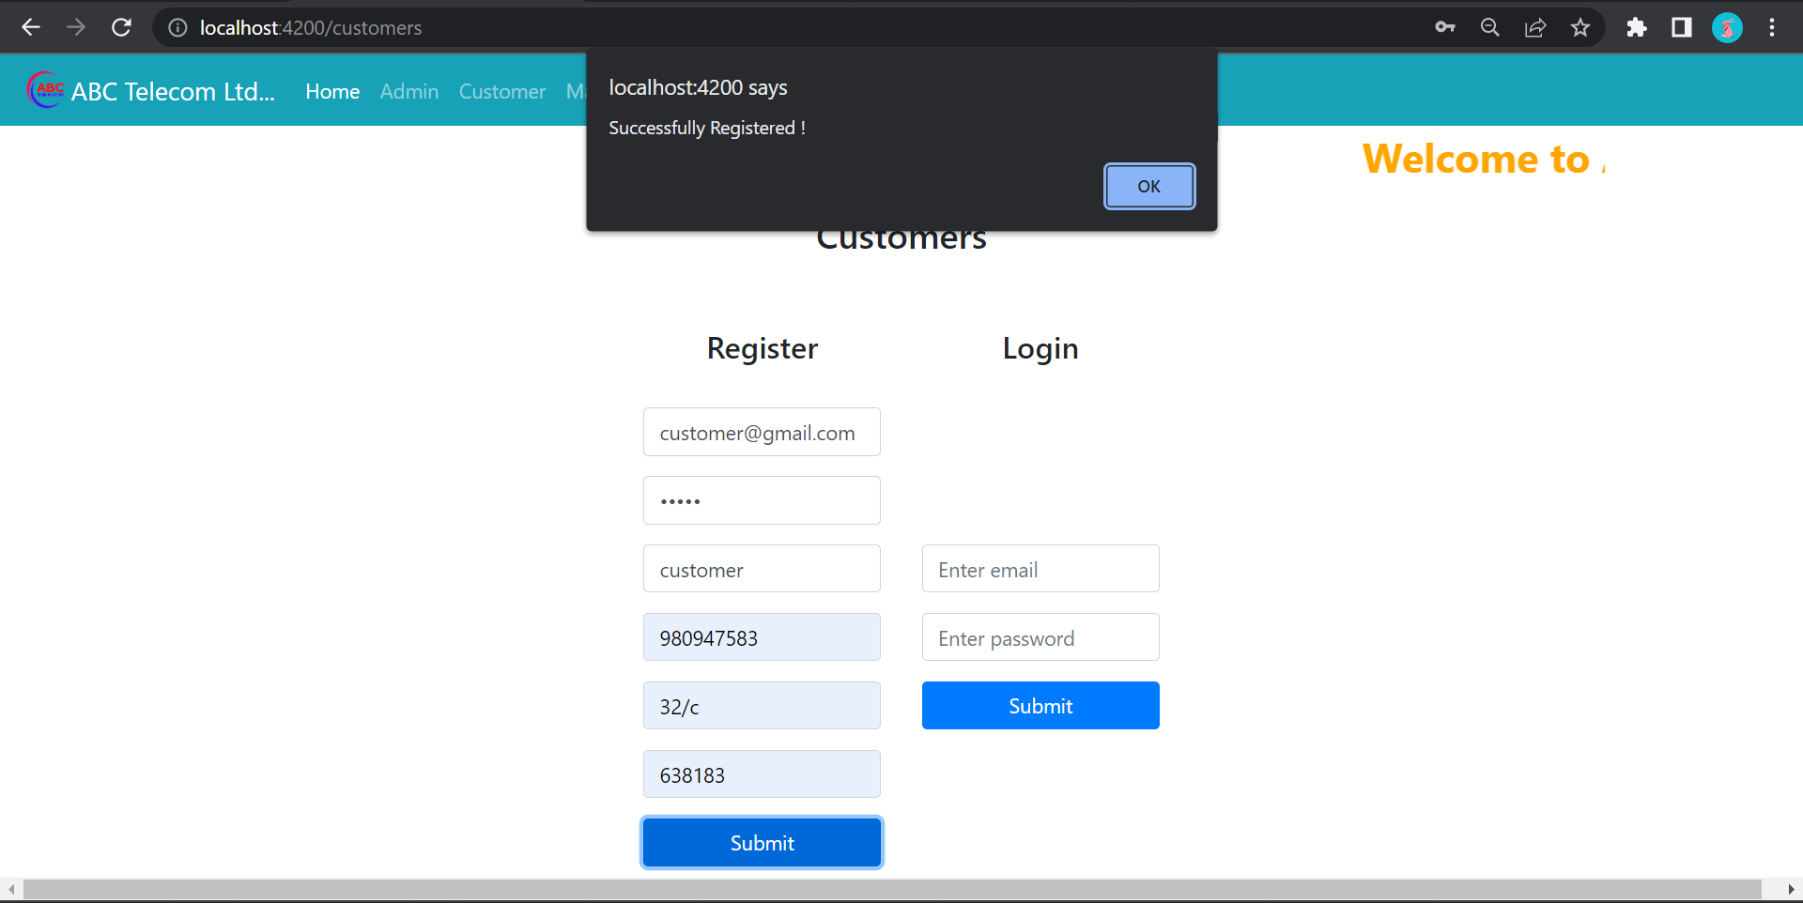

Customer Register Page:
Customer Login Page:

Slide 49

Customer Complaint Page:

Slide 50


Manager Register Page:
Manager Login Page:

Slide 51


Complaint & Feedback in Manager Page:
Manager Assign Engineer :

Slide 52


Engineer Register Page:
Engineer Login Page:

Slide 53


Engineer Status Update Page:
Customer Feedback Page:

Slide 54

Admin Page:

Slide 55


Admin – (Manager & Engineer Details):
Admin – (Customer, Complaint and Feedback Details):

Slide 56




Admin – (CRUD Operation ):

Slide 57




Admin – (CRUD Operation ):

Slide 58

Contact Page:

Slide 59
BENIFITS
User friendly application.
Easy to Register, Login and raise a complaint regarding the customer’s problem.
This allows us to rapidly identify and resolve the precise problem..
Positive feedback from the customer can lead to further more purchases

Slide 60
TOOLS AND TECHNOLOGIES:
Technologies:
For Development:
Front-End: Angular .
Back-end: MYSQL, Spring boot.
Server: Tomcat.
For testing:
Front end Testing using Selenium TestNG
Back end Testing using Postman
Tools:
Spring Tool Suite/Eclipse
Visual Studio
SQL Workbench

Slide 61
CONCLUSION
This web application is user friendly and it is provided with easy application of services.
This application was created in a very efficient, LESS time-consuming, and responsive manner.
After resolving the complaint the customer can give their valuable feedback.

Slide 62
Thankyou

